Slide 1


Database Systems
Fall 2024
Week 04 Ch 02-TB1

Slide 2
Entity–Relationship Modeling
Reading Assignment:
Chapter 2: Entity-Relationship Modeling

Slide 3
E-R Data Model
A semantic data model, used for the graphical representation of the conceptual database design
Major components are
Entities
Attributes
Relationships

Slide 4
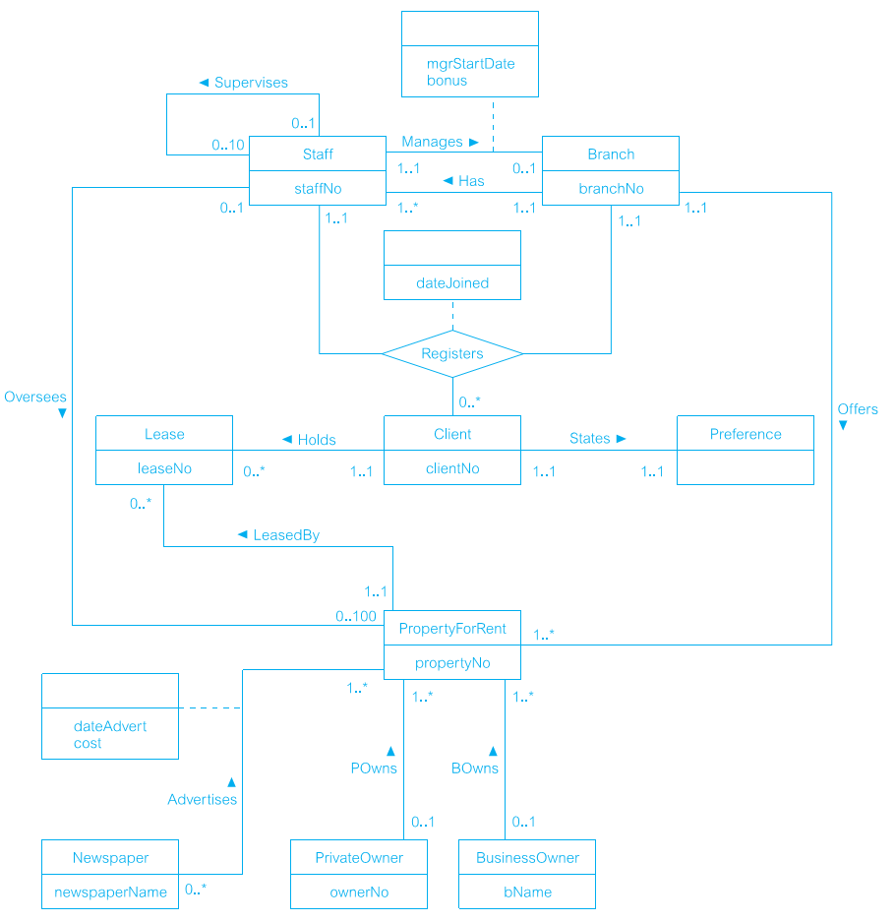
Entity Relationship (ER) diagram

Slide 5
Entity
Term used to mean three different meanings
Entity type
Entity instance
Entity set

Slide 6
Entity Type
A name/label assigned to items/objects that exist in an environment and that have similar properties
It could be person, place, event or even concept
Distinguishable from other entity types on the basis of properties
can be objects with a physical (or ‘real’) existence or objects with a conceptual (or ‘abstract’) existence

Slide 7
Entity Instance and Entity Set
A particular object belonging to a particular entity type
A uniquely identifiable object of an entity type.
Entity Type: Student
Entity Instance: Farooq, ali, hamza, umar, bse203123,
Entity Set: All Students

Slide 8
Types of Entity Types
Entity types can be classified into
Regular/Strong/Independent
Weak/Dependent

Slide 9
Strong Entity Types
A strong/regular entity type is the one whose instances can exist independently, i.e., without being linked to other instances
Strong ETs have their own identity

Slide 10
Weak Entity Types
An entity type whose instances cannot exist without being linked with instances of some other entity type, i.e., they cannot exist independently

Slide 11
Naming Entity Types
Singular noun recommended
Organization specific names
Write in capitals
Abbreviations can be used

Slide 12
Entity Symbols
Regular Entity Type
STRONG
Weak Entity Type
WEAK
EMPPLOYEE
DEPENDENTS
BOOK
BOOKCOPY

Slide 13
Attributes
An attribute of an entity type is a defining property or quality of the instances of that entity type.
Entity instances of same entity type have the same attributes. (e.g. Student Identification, Student Name)

Slide 14
Attribute Domain
Every attribute has a domain
Each attribute is associated with a set of values called a domain.
The attributes in an entity set get the values from the same domain

Slide 15
Symbols for Attributes
Each represented as an oval, linked with an ET symbol
CGPA
STUDENT

Slide 16
Types of Attributes
Single vs composite
Single valued vs multi-valued
Stored vs derived

Slide 17
Single vs composite
Simple Attribute: An attribute composed of a single component with an independent existence. It can not be further divided. Sometimes Called Atomic.
Position and Salary
SALARY (FIXED SALARY/HOURLY-BASED)
Composite Attribute: An attribute composed of multiple components, each with an independent existence.
Address (house #, street, city, postal code, country)

Slide 18
Single-Valued vs Multi-Valued
Single-valued Attribute: An attribute that holds a single value for each occurrence of an entity type.
Branch Number
Multi-valued Attribute: An attribute that holds multiple values for each occurrence of an entity type.
Phone Number

Slide 19
Derived vs Stored
Derived Attribute: An attribute that represents a value that is derivable from the value of a related attribute or set of attributes, not necessarily in the same entity type.
Duration

Slide 20
Symbols for Attributes
Simple
Composite
Multi-valued
Derived

Slide 21
Example
Experience
empId
empName
EMPLOYEE
address
dateHired
emp_Qual
street
houseNo

Slide 22
An attribute or set of attributes to identify an entity instance uniquely
Types
Super key
Candidate key
Composite
Primary key

Slide 23
Relationship
Relationship type: A set of meaningful associations among entity types.
Relationship Occurrence: A uniquely identifiable association, which includes one occurrence from each participating entity type.

Slide 24
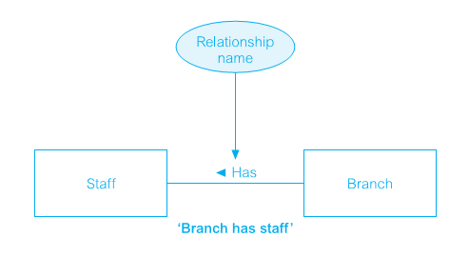
Relationship Representation

Slide 25
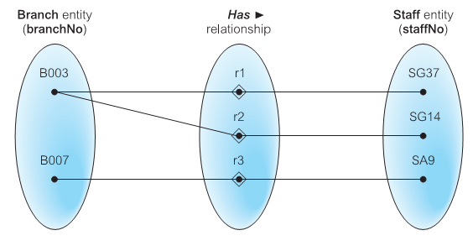
Individual Occurrences of HAS relationship type

Slide 26
Naming
STUDENT and COURSE have ENROLL relationship
However, it can also be named as STD_CLS

Slide 27
Participants
Entities involved in a relationship are called its participants
The participation of an entity in a relationship is total participation when all entities of that set might be participant in the relationship otherwise it is partial participation.
if every Part is supplied by a Supplier

Slide 28
Degree of Relationship Type
The number of participating entity types in a relationship.
Unary Relationship
A Binary relationship is the one that links two entity sets e.g. STUDENT-CLASS
A Ternary relationship is the one that involves three entities e.g. STUDENT-CLASS-FACULTY.

Slide 29
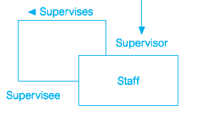
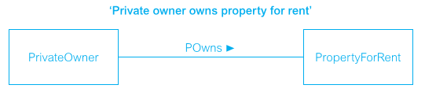
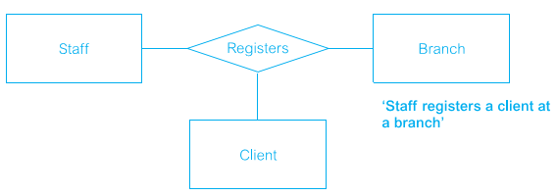
Degree of Relationship Type

Slide 30
Relationship Types
Relationships can be formally described in an ordered pair form.
For Example,
Enroll = {(S1001, ART103A), (S1020, CS201A), (S1002, CSC201A)}
Example {(S1013, MCS4, Adnan), (S1023, MCS3, Ahmed)}
Entire set is relationship set and each ordered pair is an instance of the relationship.

Slide 31
Cardinality of Relationships
Number of instances of one entity type that can possibly be related to instances of other entity type
Types of Cardinalities
One to One (1:1)
One to Many (1:*)
Many to Many (*:*)

Slide 32
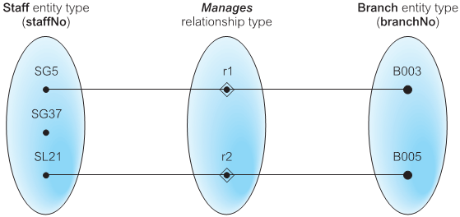
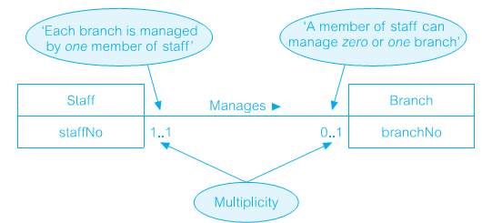
One to One (1:1)

Slide 33
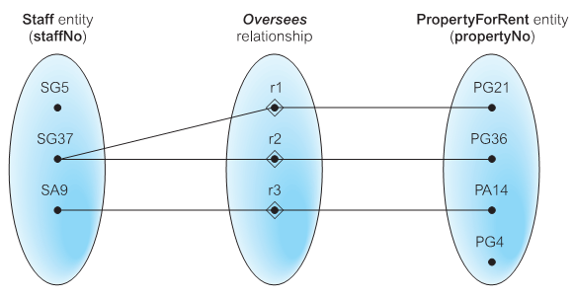
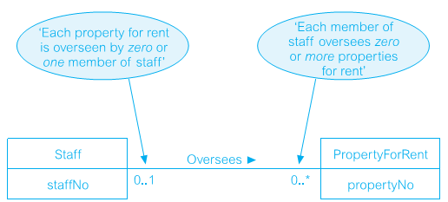
One to Many (1:*)

Slide 34
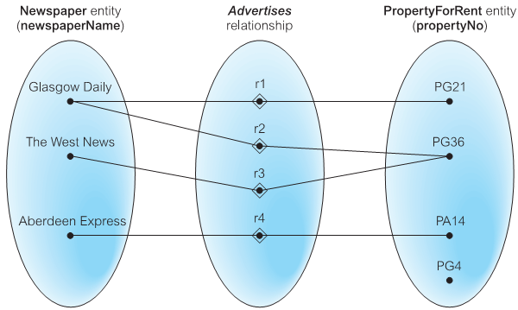
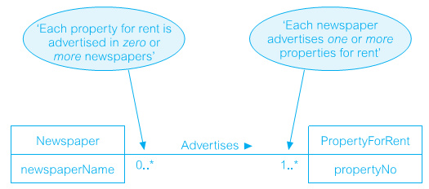
Many to Many (*:*)

Slide 35
Thank You

